Slide 1
ALGORITHM RECURSION LINEAR SEARCH BINARY SEARCH

Slide 2
Table of contents
02.
01.
Algorithm
Recursive
03.
04.
Binary search
Linear Search

Slide 3
01.
ALGORITHM

Slide 4
About
Algorithm
An algorithm is a procedure used for solving a problem or performing a computation. Algorithms act as an exact list of instructions that conduct specified actions step by step in either hardware- or software-based routines. Here are 8 critical steps in the development of an efficient algorithm :
Definition of the problem
Development of a model
Specification of the algorithm
Designing an algorithm
Implementation of the algorithm
Program testing

Slide 5
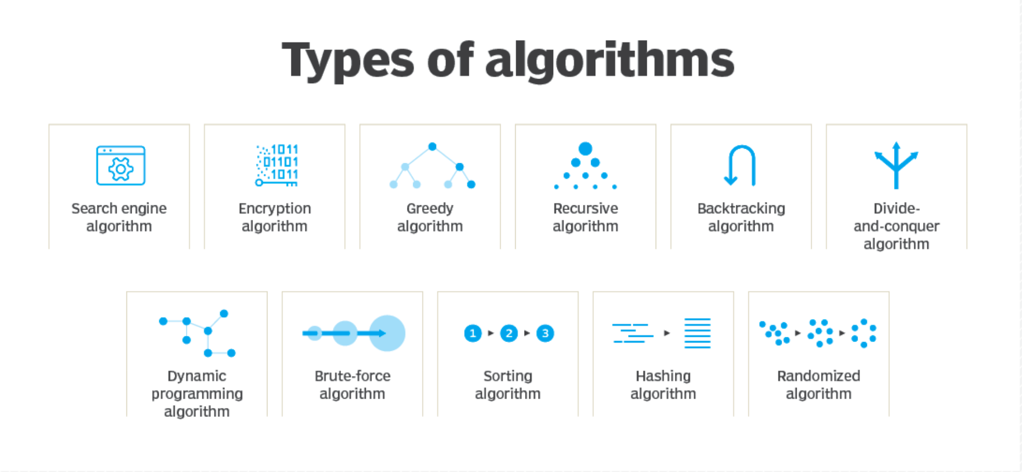

Slide 6

How does algorithm work?
Algorithms can be expressed as natural languages, programming languages, pseudocode, flowcharts and control tables.
Algorithms use an initial input along with a set of instructions.
The input is the initial data needed to make decisions and can be represented in the form of numbers or words. The input data gets put through a set of instructions, or computations, which can include arithmetic and decision-making processes. The output is the last step in an algorithm and is normally expressed as more data.

Slide 7

Importance of ALGORITHM
It is a step-wise representation of a solution to a given problem, which makes it easy to understand.
An algorithm uses a definite procedure.
It is not dependent on any programming language, so it is easy to understand for anyone even without programming knowledge.
Every step in an algorithm has its own logical sequence so it is easy to debug.
By using algorithm, the problem is broken down into smaller pieces or steps hence, it is easier for programmer to convert it into an actual program.

Slide 8
RECURSIVE ALGORITHM
Recursive algorithms are powerful tools
that offer clever solutions to complex problems. In this presentation, we'll explore the definition, examples, advantages, and disadvantages of recursion. We'll also compare recursion to iteration and discuss some best practices for implementation.

Slide 9
Examples of Recursive Algorithms
Factorial
n! = n * (n-1) * (n-2) * ... * 1. Recursive formula: n! = n * (n-1)!
Fibonacci Sequence
The sequence starts with 0, 1 and the next term is the sum of the previous two terms. Recursive formula: F(n) = F(n-1) + F(n-2)
Merge Sort
A divide-and-conquer algorithm that recursively divides an array into smaller sub-arrays, sorts them, and merges the sorted arrays.

Slide 10
Advantages of Using Recursive Algorithms
Simplicity
Recursive algorithms are easy to read and understand, especially for problems that naturally exhibit recursive structure.
Modularity
Recursive algorithms can be divided into smaller, more manageable sub-problems.
Efficiency
Recursive algorithms can be faster and use less memory in some cases than iterative algorithms.

Slide 11
Disadvantages of Using Recursive Algorithms
Overhead
Recursive algorithms have to manage the call stack, which can lead to increased memory usage and slower performance.
Stack Overflow
Recursive algorithms that do not have proper termination conditions can lead to stack overflow, where the call stack exceeds its limit.
Difficult Debugging
Recursive algorithms can be difficult to debug, especially when the call stack is deep.

Slide 12
LINEAR SEARCH
Linear search, also known as sequential search, checks each item in a list or array until the desired item is found. It's best used on small datasets or unordered lists, as it takes a long time on large ones.

Slide 13
Time Complexity and Analysis
Time Complexity
Linear search can have a time complexity of O(n), which means that the amount of time it takes to search is directly proportional to the size of the dataset. This is because linear search must search through each element one at a time.
Size of Dataset
For small amounts of data, linear search is a sufficient and efficient option. As the dataset grows larger, however, more advanced and faster algorithms become necessary.
Best Case and Worst Case
In the best-case scenario, the search is completed in a single pass, and the time complexity is O(1). In the worst-case scenario, the element is not found after a complete pass, and the time complexity is O(n).

Slide 14
Advantages and Limitations of Linear Search
Easy to implement.
Effective on small sets of data.
Does not require any special precautions.
Part of the foundation of many other search algorithms.
Efficient only on small sets of data.
Takes a long time to execute on larger data sets.
No ability to sort or reorder.
Non optimal search technique for ordered lists.

Slide 15
BINARY SEARCH
Binary search is a powerful algorithm used to search a sorted list efficiently. In this presentation, we will cover its intricacies and applications, as well as its pros and cons.

Slide 16
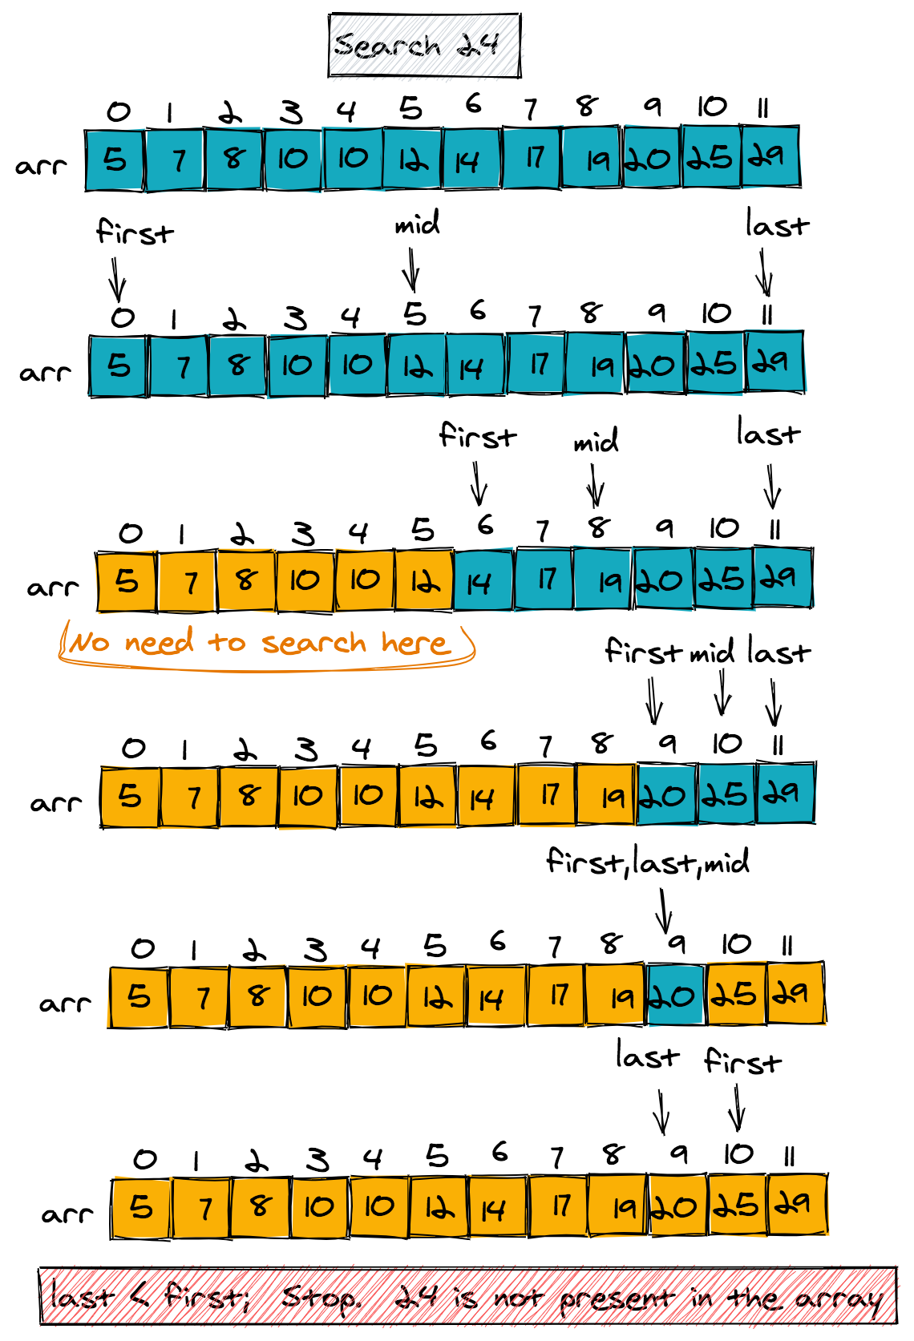
What is Binary Search?
A Sorted List
In binary search, we search through a sorted list by continuously splitting it into halves until we find the element we're looking for. This makes it a very efficient search algorithm.
A Power of 2
The algorithm requires our list to be sorted and evenly divided into powers of two. This means that each comparison dramatically reduces the possible search space.

Slide 17
Performance Analysis
Time Complexity
Binary search has an O(log n) time complexity, making it very efficient for large lists. Its logarithmic growth means that time increases slowly even when the list size doubles!
Space Complexity
Binary search has an O(1) space complexity, meaning that space requirements remain constant regardless of the size of the list. This means it's memory-efficient as well as fast!

Slide 18
Advantages and Disadvantages
Advantages Binary search is a highly efficient algorithm used in many applications like AI, DB searching, and data mining, where searching is the critical task.
Disadvantages The algorithm works only with sorted lists and can't be used with unsorted data. If the list is not sorted, we need to spend time sorting, reducing its efficiency.

Slide 19
Thank you!
Do you have any questions?
youremail@freepik.com
+91 620 421 838
yourwebsite.com
Please keep this slide for attribution

